Slide 1
De-mystifying APIs
BIOS 6640
R for Data Science

Slide 2
Application programming interface (API)

Slide 3
Outline
Software library APIs
Web APIs

Slide 4

APIs are like Legos

Slide 5
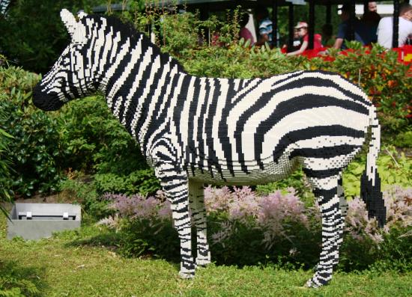
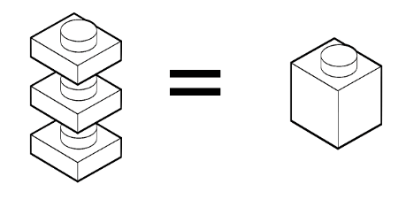
What do you get with Legos?
Pieces that fit together in specified ways
Instructions on how they fit together
Freedom to be creative within those constraints

Slide 6





What do you get to ignore?
Chemistry of plastics
Engineering
Business administration
Manufacturing
Supply chain

Slide 7
Application programming interface (API)
The “public face” of a software resource
Set of clearly defined methods of interaction between software components
Abstract away underlying implementations
Only expose high level information

Slide 8
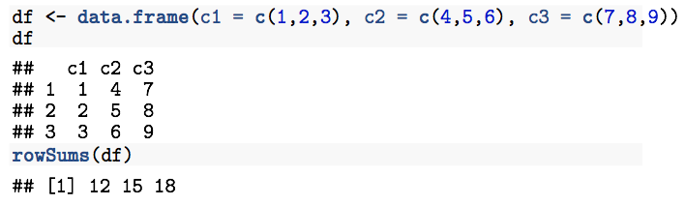

R functions
rowSums()
Create a data frame and get its row sums
data.frame()

Slide 9
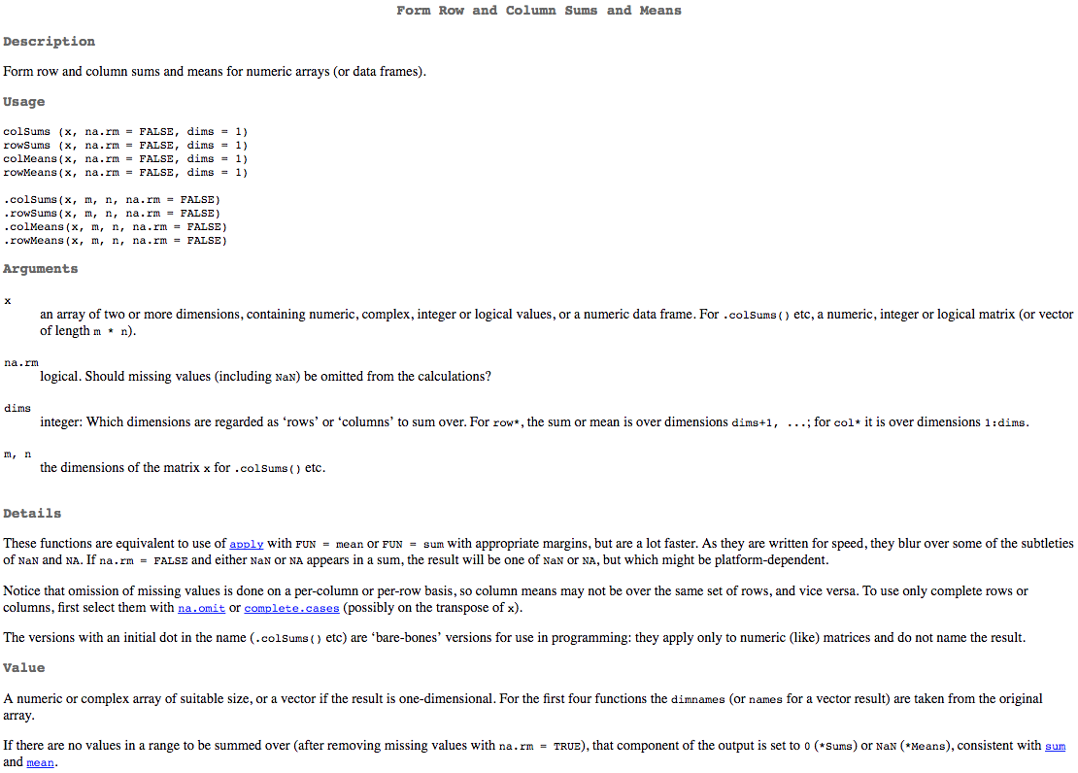
API exposes what you need and hides the details

Slide 10
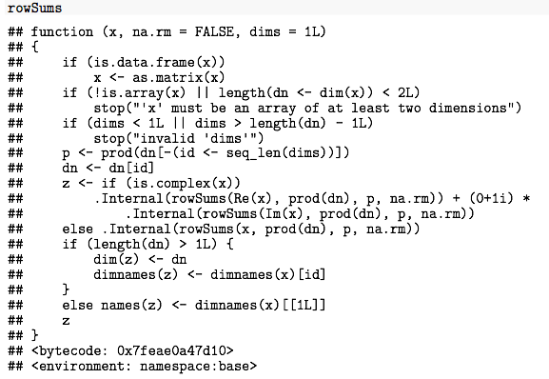
rowSums implementation

Slide 11
R package API is defined by...
Exported functions/classes
Function/method signatures
Documentation

Slide 12
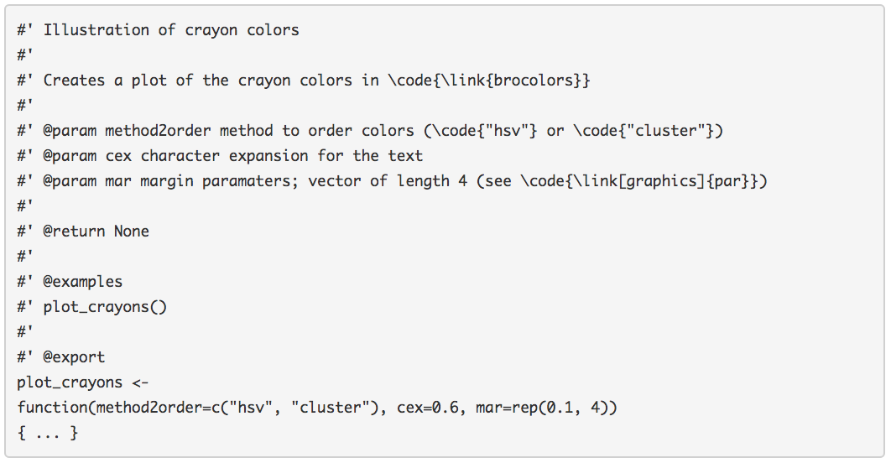
Defining the API
Documentation
Export
Function name
Function signature
http://kbroman.org/pkg_primer/pages/docs.html

Slide 13
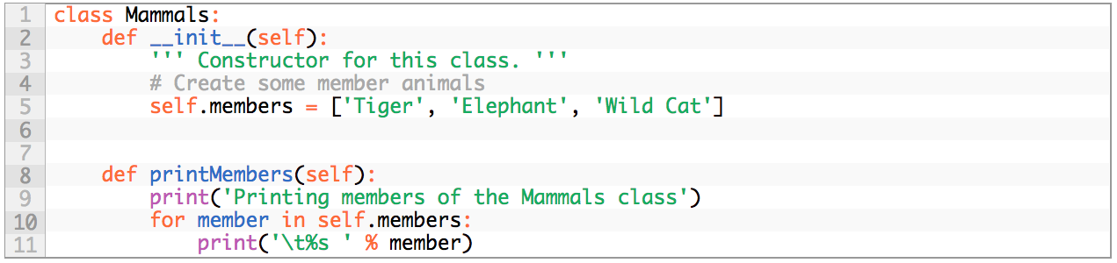
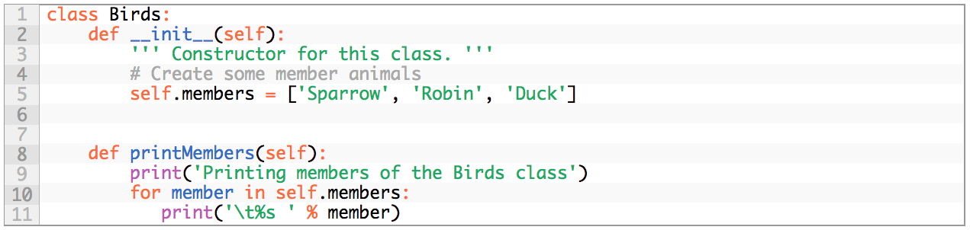
Python
Define a module
Define another module
Package __init__.py
http://www.pythoncentral.io/how-to-create-a-python-package/

Slide 14
In general, an API can include definitions of...
Routines (functions/methods)
Classes
Data structures
Variables (values)

Slide 15
The API does not include...
Actual implementations

Slide 16

If you’re developing software...
A good API is one of the hardest and most important design elements!
Simple, easy to understand
The right level of modularity
The right level of flexibility

Slide 17
Types of APIs
Software libraries (previous slides)
Language binding
Operating system
Database
Hardware
Web service

Slide 18
Web APIs
Business/organization exposes data publicly over the web
Provide an API to access the data

Slide 19
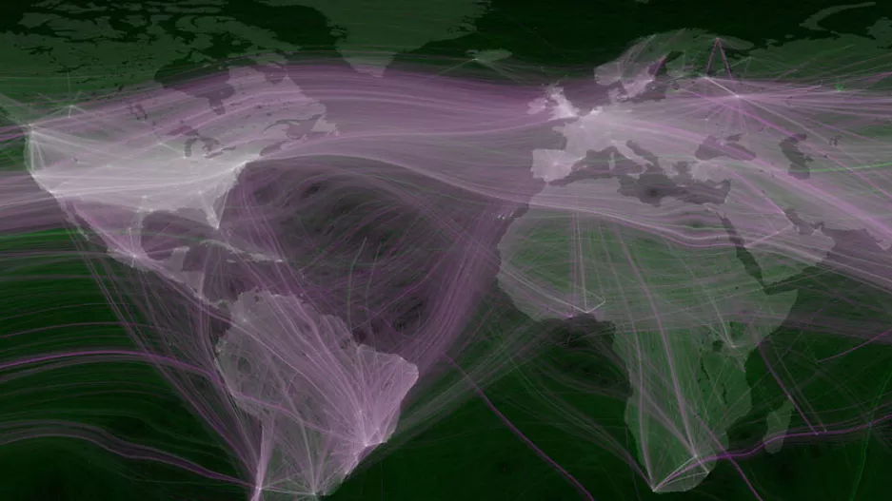
Twitter
https://www.fastcodesign.com/1665780/infographic-of-the-day-mapping-the-worlds-tweet-networks

Slide 20
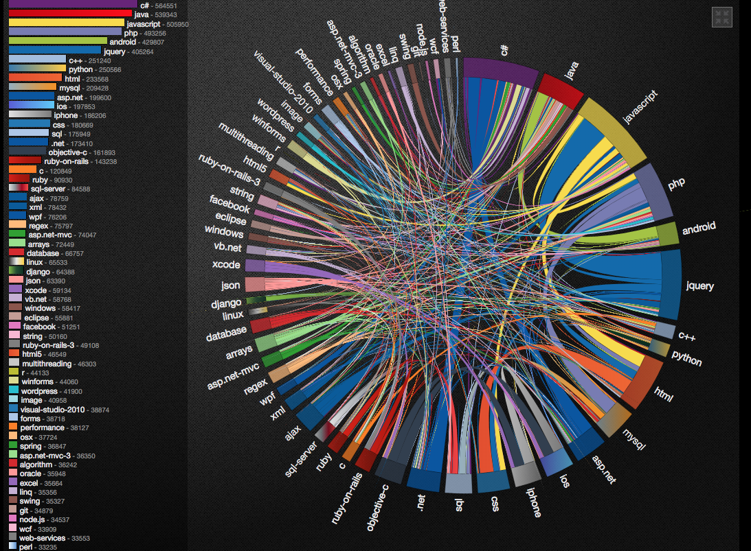
Stack Overflow / Stack Exchange
http://graphoverflow.com/graphs/stackoverflow-tag-relations.html

Slide 21
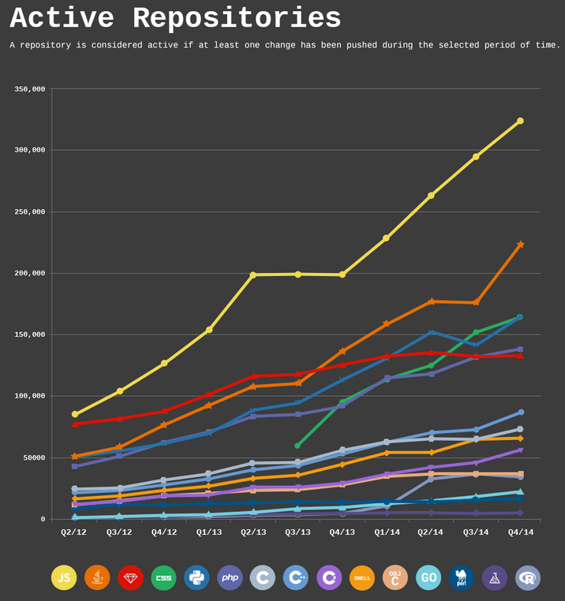
GitHub
https://adtmag.com/articles/2015/08/20/github-languages.aspx

Slide 22
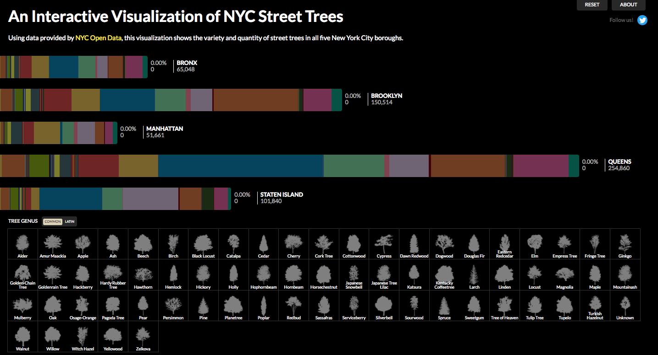
NYC Open Data
https://www.cloudred.com/labprojects/nyctrees/

Slide 23
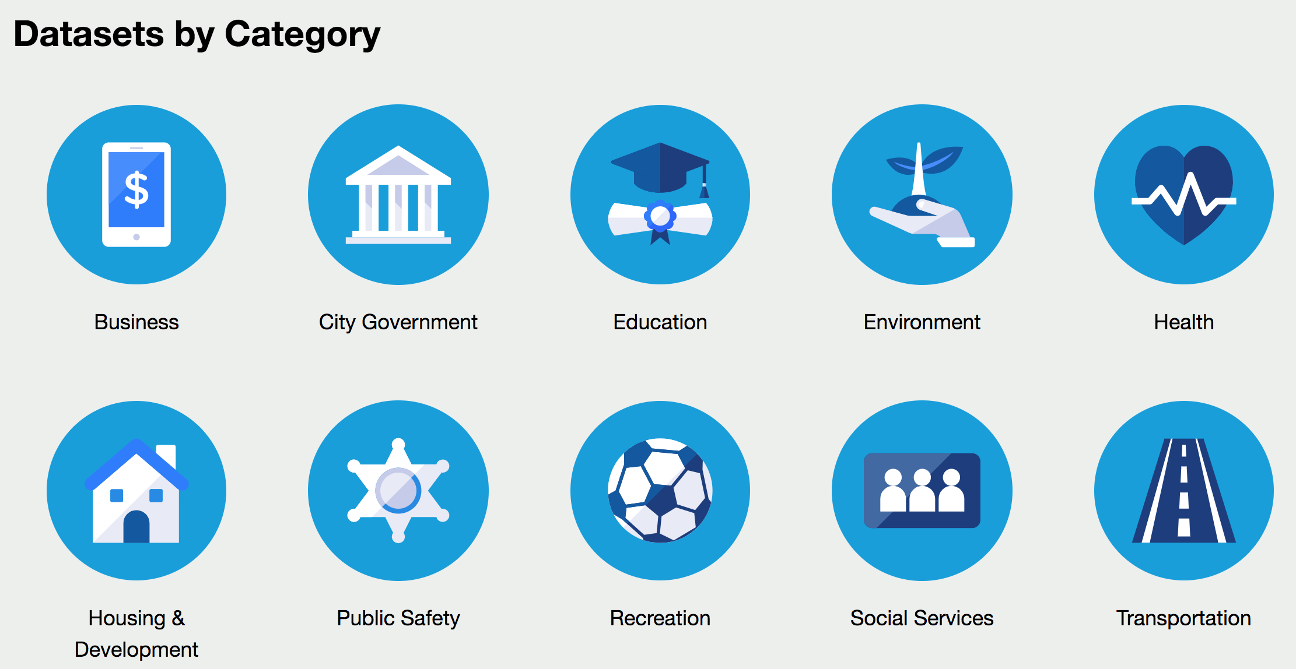
NYC Open Data: over 1,600 datasets

Slide 24
Web APIs
Business/organization database
Publicly exposed data endpoints
Publicly available request-response system
Responses returned as JSON or XML
Usually exposed via HTTP server
Most common type of web API: REST API
Notes:
REST is an architectural style for web APIs.
REST: representational state transfer
Constraints:
Client-server architecture
Statelessness
Cacheability
Layered system
Uniform interface
Code on demand (optional)

Slide 25
Ways to use web APIs
Directly by making HTTP requests
With a client library written in your favorite language

Slide 26
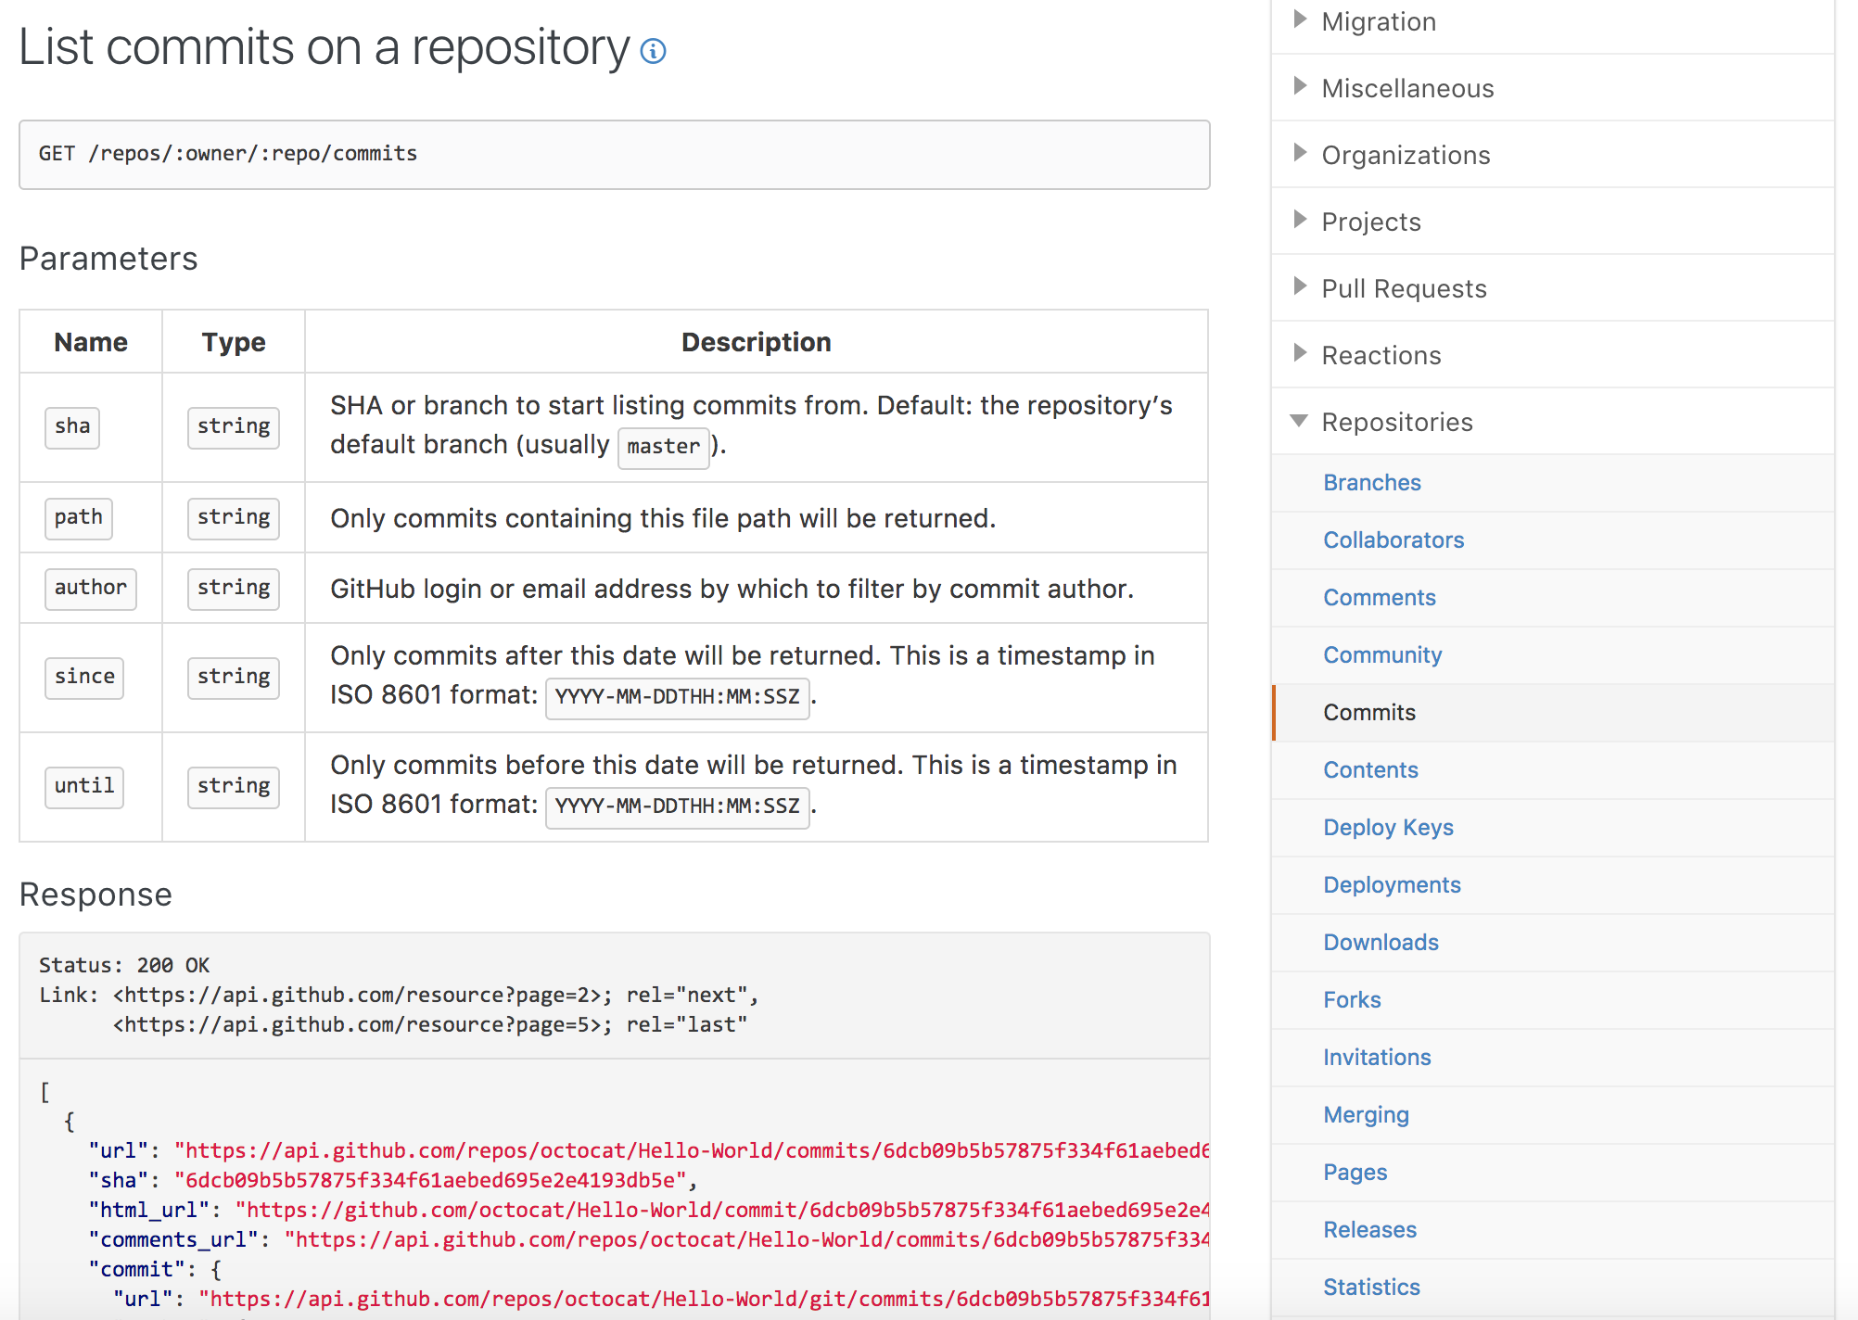
API documentation

Slide 27
Endpoints
Define the location of resources that can be accessed.
Example: GitHub API endpoints
Events
Repositories
Commits
Users
Comments
Milestones
Etc...

Slide 28
Sending requests to a REST API
Typically, HTTP methods are supported. Most commonly used:
GET, PUT, DELETE
Requests can be issued via URLs.

Slide 29
Example: GitHub “users” endpoint
https://api.github.com/users/ghoshd
{ "login": "ghoshd", "id": 8326121, "node_id": "MDQ6VXNlcjgzMjYxMjE=", "avatar_url": "https://avatars3.githubusercontent.com/u/8326121?v=4", "gravatar_id": "", "url": "https://api.github.com/users/ghoshd", "html_url": "https://github.com/ghoshd", "followers_url": "https://api.github.com/users/ghoshd/followers", "following_url": "https://api.github.com/users/ghoshd/following{/other_user}", "gists_url": "https://api.github.com/users/ghoshd/gists{/gist_id}", "starred_url": "https://api.github.com/users/ghoshd/starred{/owner}{/repo}", "subscriptions_url": "https://api.github.com/users/ghoshd/subscriptions", "organizations_url": "https://api.github.com/users/ghoshd/orgs", "repos_url": "https://api.github.com/users/ghoshd/repos", "events_url": "https://api.github.com/users/ghoshd/events{/privacy}", "received_events_url": "https://api.github.com/users/ghoshd/received_events", "type": "User", "site_admin": false, "name": "Debashis Ghosh", "company": null, "blog": "", "location": null, "email": null, "hireable": null, "bio": "Professor and Chair, Biostatistics and Informatics, Colorado. Lover of Data, Inference, Computing and Coffee, not necessarily in that order. ", "public_repos": 3, "public_gists": 0, "followers": 5, "following": 1, "created_at": "2014-08-01T03:47:59Z", "updated_at": "2019-07-17T15:19:30Z" }

Slide 30
Resources to simplify REST API access
Most languages have libraries to handle HTTP requests
Popular APIs have specialized libraries in multiple languages

Slide 31
R package: httr
Tools for working with HTTP requests
Handles authentication

Slide 32
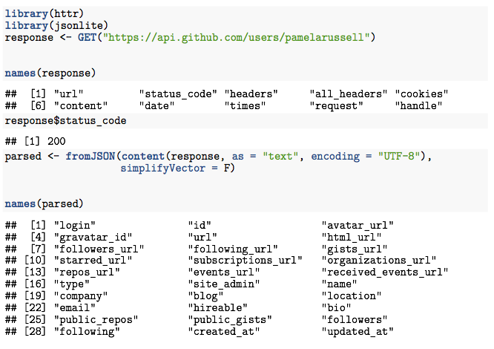
httr usage
Notes:
simplifyVector: coerce json arrays containing only primitives into an atomic vector

Slide 33
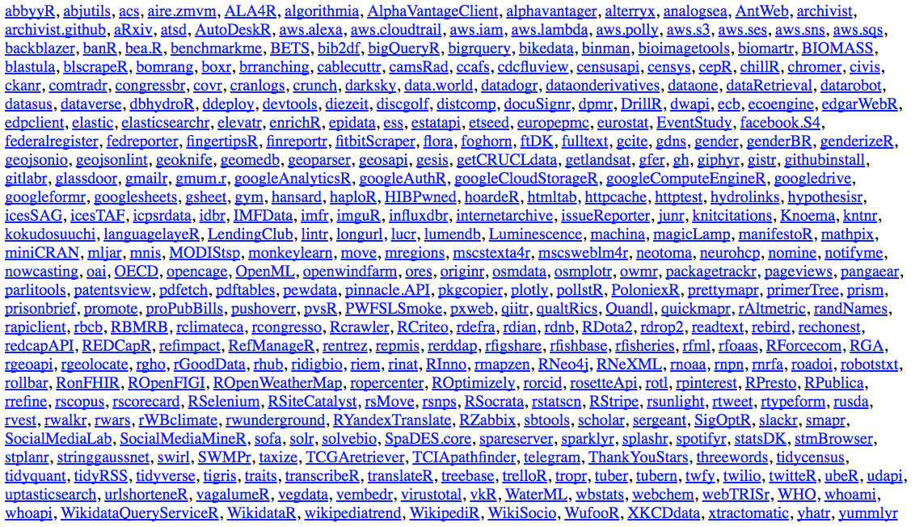
R packages for specific REST APIs
Notes:
Packages that import httr

Slide 34
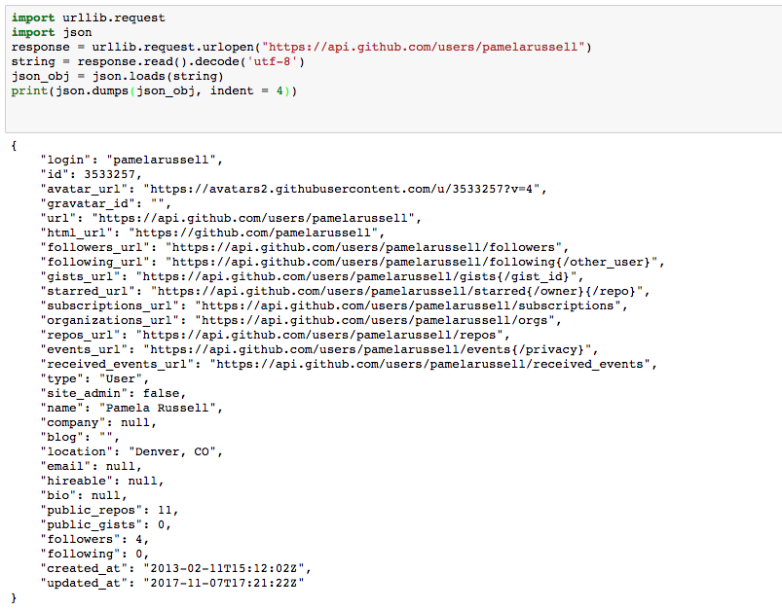
Python package urllib

Slide 35
Authentication
Some APIs require credentials for access.
Most popular authentication method: OAuth.
Organization provides user with a “client secret”; the “client secret” is included with each API request. Lets you grant access to your credentials without sharing your password.

Slide 36
Conclusion
APIs provide an interface to a resource and abstract away the implementation details
Software libraries define APIs that frame their usage
Web APIs provide access to data over the web
R and Python can be used to access rich web resources through HTTP requests or higher level wrappers for specific APIs

Slide 37
Acknowledgments
Pam Russell

